Slide 1
NY House Sales Analysis Charts
File created on: 8/13/2025 12:23:11 PM

Slide 2
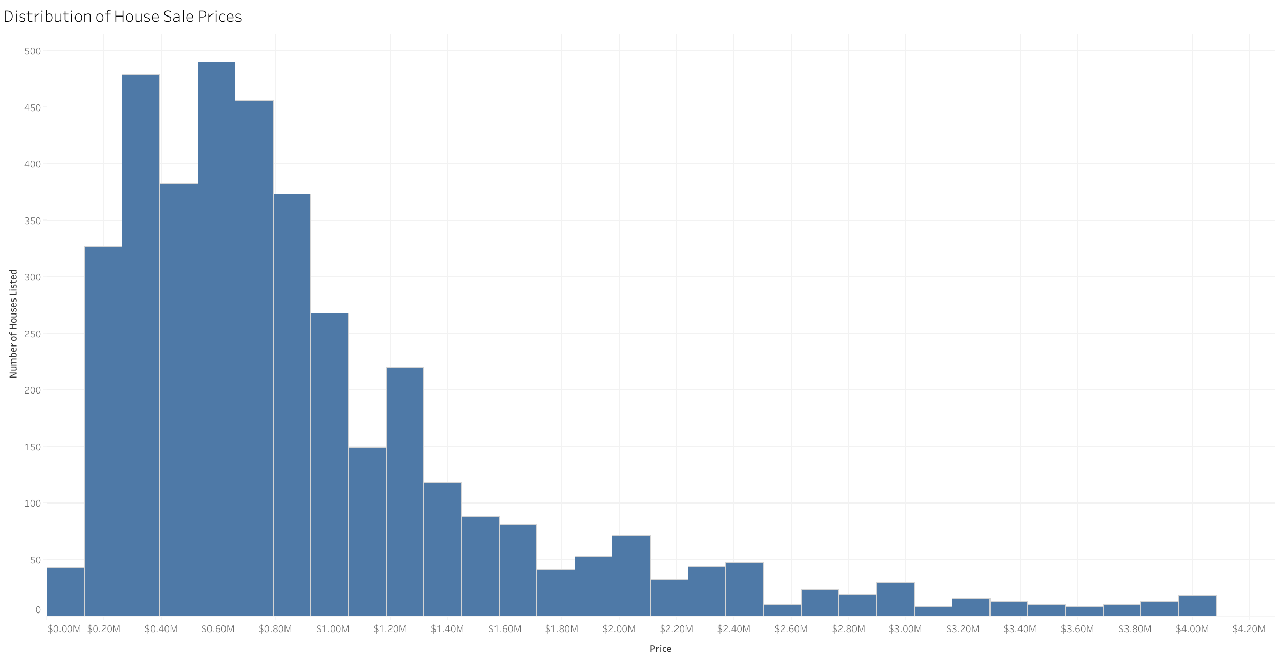

Slide 3
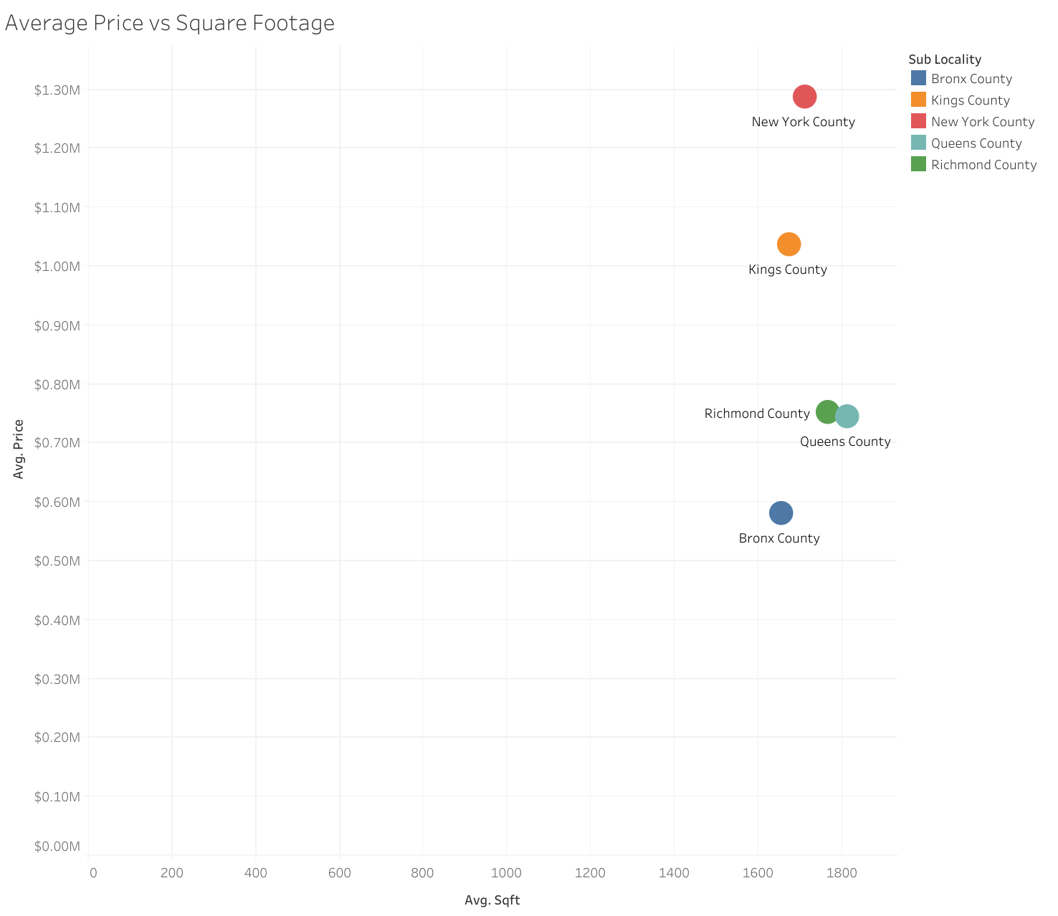

Slide 4
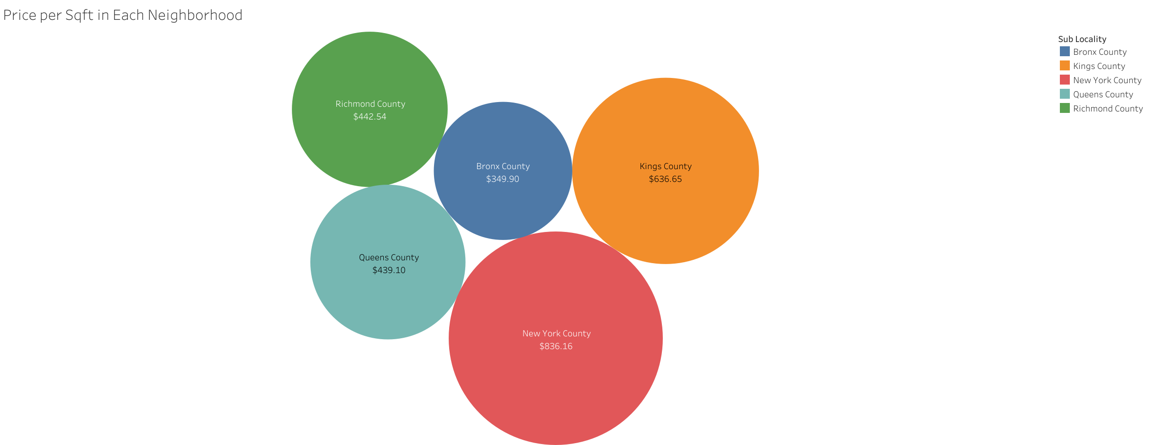

Slide 5
